Slide 1

OCEANSENSE
OceanSense: An IoT-Based Hybrid System for Real-Time Detection and Tracking of Marine Debris
Group ID : 25-26J-002

Slide 2
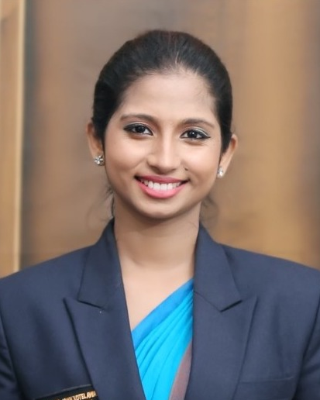



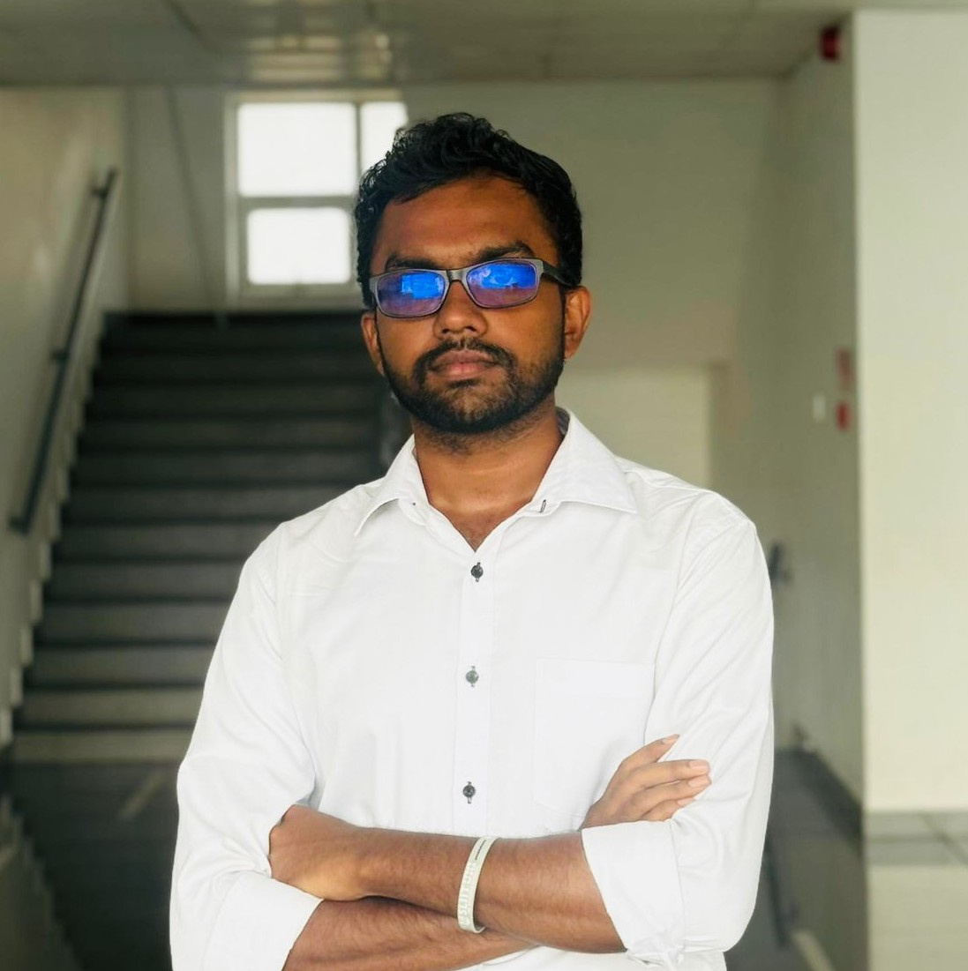
Our Research Team
Ms. Dinithi Pandithage
Supervisor
Ms. Narmada Gamage
Co-Supervisor
Jayasak D.L.C.
Leader
Rathnayake G.R.M.S.D.
Member
Abeysinghe P.T.G.S.R.
Member

Slide 3
OceanSense: An IoT-Based Hybrid System for Real-Time Detection and Tracking of Marine Debris
PP2 Comments
Panel comments | Solution
Incorporate energy harvesting mechanisms | Designed and implemented a hybrid energy harvesting system, including wave-driven energy generation to enable operation during low or no sunlight conditions
Improve clarity of the problem statement | Enhanced problem definition by incorporating real-world statistics and contextual data on marine debris and energy constraints
Complete the system design | Developed a comprehensive and practical device architecture tailored for deployment in ocean environments
Implement LoRa to working status | Implemented node to node communication via LoRa
ERAC to control real packets | Integrated the ERAC protocol to manage real-time packet transmission and adaptive LoRa communication control

Slide 4
OceanSense: An IoT-Based Hybrid System for Real-Time Detection and Tracking of Marine Debris
Problem
Marine plastic pollution is a global crisis
Existing systems:
❌ Expensive (satellites, patrols)
❌ Limited coverage
❌ High energy consumption
Challenges:
Low communication bandwidth (LoRa limits)
Dynamic ocean conditions (waves, currents)
No scalable decentralized solution
👉 Core Problem: How to efficiently track marine debris using low-power, decentralized autonomous systems

Slide 5
Design Excellence
ERAC: Environment-Responsive Adaptive Coordination
Swarm dynamically adapts using:
Wave height
Ocean currents
Debris density
Decentralized Swarm Intelligence
No central controller
Each ASV makes autonomous decisions
LoRa-Based Communication
Long-range, low-power
Works under bandwidth constraints
Edge AI Processing
On-device debris detection
Only metadata transmitted
Self-Healing Capability
Detects node failures
Automatically redistributes tasks

Slide 6
IT22908360 Jayasak D.L.C.
Specialization – Computer Systems & Network
Engineering
Node Designing and Self-Healing Mechanism Description: Design of buoyant sensor node with hardware components and autonomous fault recovery
Novelty: Lightweight self-healing mechanism without centralized control
IT22908360 | Jayasak D.L.C. | 25-26J-002

Slide 7

IT22228130 Rathnayake G.R.M.S.D.
Specialization – Computer Systems & Network
Engineering
ERAC-MAC: Energy-Aware, Resilient, Adaptive MAC Protocol Description: LoRa-based communication protocol optimized for low power and efficient data transmission
Novelty: Energy-aware scheduling integrated with swarm communication
IT22228130 | Rathnayake G.R.M.S.D. | 25-26J-002

Slide 8
IT22253576 Abeysinghe P.T.G.S.R.
Specialization – Computer Systems & Network
Engineering
Environment-Aware Swarm Coordination
Description: Decentralized swarm control adapting to wave, current, and debris conditions
Novelty: Real-time environment-driven adaptive coordination under low-bandwidth constraints
IT22253576 | Abeysinghe P.T.G.S.R. | 25-26J-002

Slide 9
Member 04
Environment-Aware Swarm Coordination
Description: Edge ML for Debris Detection & Drift Prediction
Novelty: Hybrid edge–central ML framework with federated-style updates, combining low-cost local inference with global intelligence.
Member 04

Slide 10
Results & Testimonials
🔹 Results
Improved area coverage efficiency
Stable adaptive swarm formation
Reliable LoRa communication performance
Faster recovery from node failures
Reduced energy consumption
🔹 Testimonials / Evaluation
Successfully validated in simulation environment
Outperformed non-adaptive baseline approaches
Demonstrated robust decentralized coordination

Slide 11
Limitations and Future Work
🔹 Limitations
Tested only in simulation (no full real-world deployment)
Limited by LoRa bandwidth constraints
ML accuracy depends on dataset quality
🔹 Future Improvements
Real-world ASV implementation
Improve AI model accuracy & speed
Hybrid communication (LoRa + other networks)
Advanced swarm intelligence.

Slide 12
Thank You for your guidance and advices in this entire project …. You guys are amazing……!

